Slide 1
Cuda parallelism
Team sirius
Rosario a. Cali Max fainshtein
Joseph pildush mithilan Sivanesan

Slide 2
agenda
Assignment 1
Algorithms
Box Filter
Data Compression
Vehicle Detection
Assignment 2
OpenCV + CUDA = Awesome Box Filter
Assignment 3
OpenCV + more CUDA = Superb Box Filter

Slide 3
Assignment 1 – algorithms
Algorithms implemented serially:
std::sort
Saxpy
Prefix Sum

Slide 4


Assignment 1 – Box filter
An average-of-surrounding-pixel kind of image filtering
Takes 134.68 seconds to process a 4k image on a CPU serially

Slide 5
Assignment 1 – Data compression
An Implementation of the LZW algorithm
Takes 2.66 seconds to process a text file with 535,999 words on a CPU serially
File size is about 5.32 MB

Slide 6
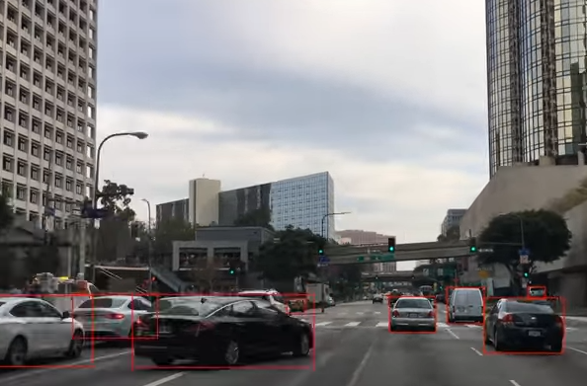
Assignment 1 – Vehicle detection
Detecting vehicles using the DLIB library and a Convolutional Neural Network
Takes 21.01 minutes to process a 10 seconds video

Slide 7
Assignment 2 – awesome box filter
Why the Box Filter problem:
More chances to succeed
Easier to Implement
Great Improvements
Our Approach:
Use OpenCV to open and close images
Create a grid size to cover the whole image
Launch a simple kernel

Slide 8
Assignment 2 – awesome box filter

Slide 9
Assignment 3 – superb box filter
However, there was still a problem…
Here’s how we solved it:
Find the Compute Capability of the GPU
Calculate the number of Threads per Block
Calculate the number of Blocks based on the image
This improved the Kernel Concurrency to 23%

Slide 10
Assignment 3 – superb box filter

Slide 11
Q&A

Slide 12
Resources and references
Code: https://github.com/RosarioAleCali/DPS915_Final_Project
Wiki: https://wiki.cdot.senecacollege.ca/wiki/Sirius
Course Notes: https://scs.senecac.on.ca/~gpu610/pages/content/index.html
Vehicle Detection: http://blog.dlib.net/2017/08/vehicle-detection-with-dlib-195_27.html
LZW Algorithm: https://codereview.stackexchange.com/questions/86543/simple-lzw-compression-algorithm

